Slide 1


AWS Cloud Services
Technical sharing
DucPV - TechMey

Slide 2
Agenda
Introduction Cloud Computing
Introduction Amazon Cloud

Slide 3
Introduction Cloud Computing

Slide 4
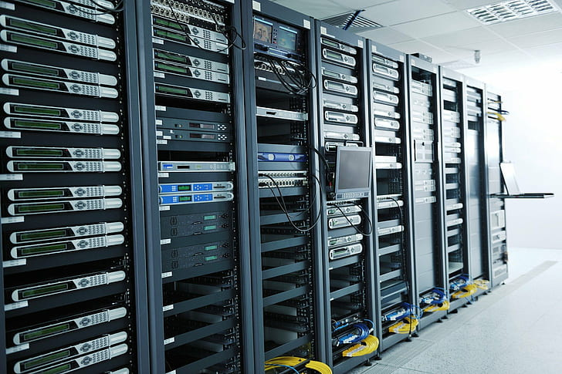
What is a server look like ?
Server room
Hardware (RAM, CPU…)
Network
Electric
Cooling system
…
Notes:
Một hệ thống server cần những gì ?
Phòng đặt server
Mua các thiết bị phần cứng
Setup mạng
Điện
Hệ thống làm mát …
=> Chi phí tốn kém

Slide 5
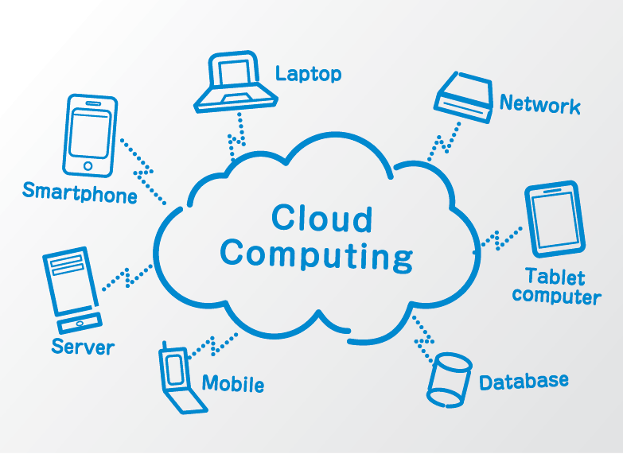
What is Cloud Computing ?
Cloud computing is the delivery of computing resources as a service, meaning that the resources are owned and managed by the cloud provider rather than the end user.
Benefit of Cloud Computing
Cost savings
Convenient
Safe and Continuous
Easy to implement

Slide 6
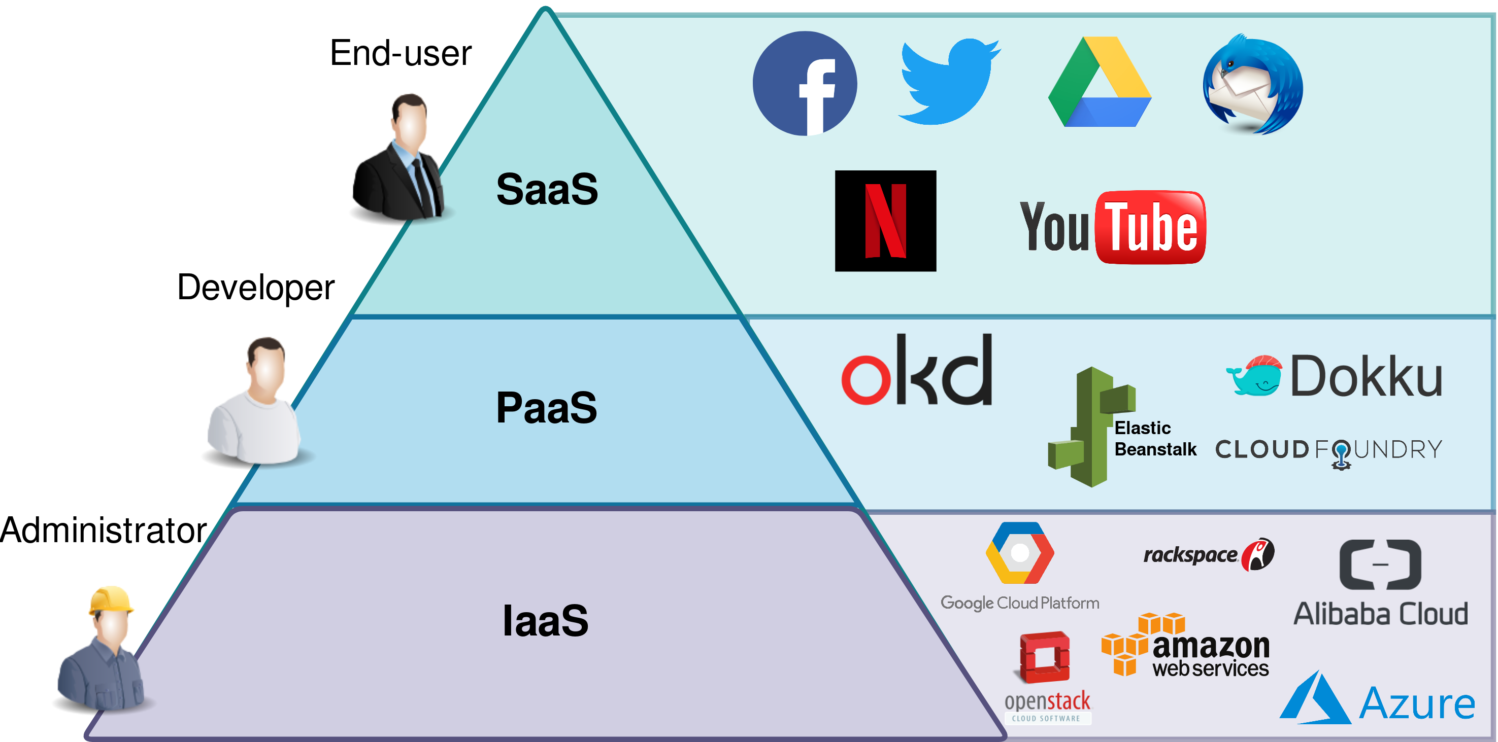
Cloud Delivery Models
Infrastructure as a Service (IaaS)
Platform as a Service (PaaS)
Software as a Service (SaaS)

Slide 7
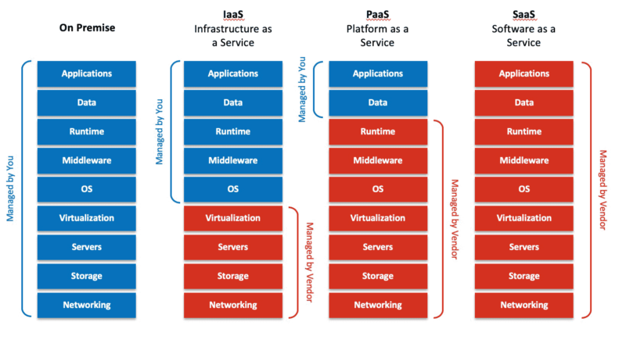

Slide 8
Introduction AWS

Slide 9

What is AWS?
AWS provides a highly reliable, scalable, low-cost infrastructure platform in the cloud that powers millions of businesses in over 190 countries around the world.
Benefits
Low Cost
Elasticity & Agility
Open & Flexible
Secure
Global Reach

Slide 10
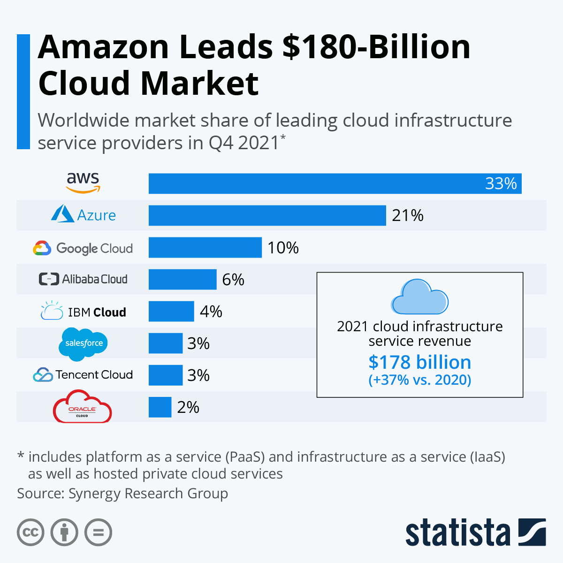
AWS Recognized as a Cloud Leader from 2006

Slide 11
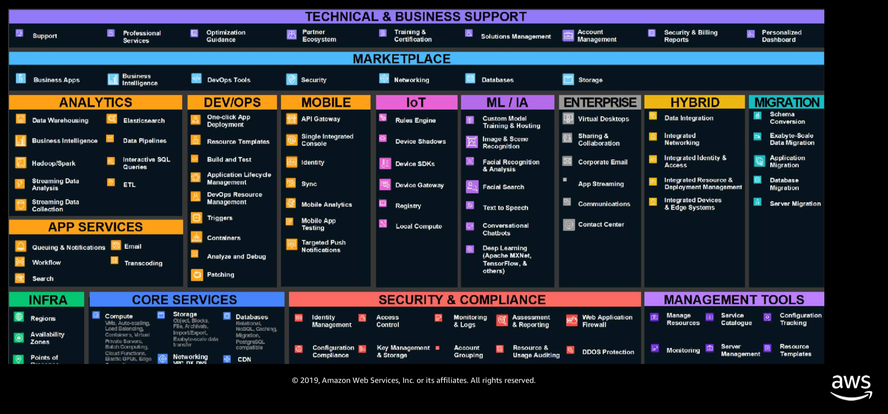

Slide 12
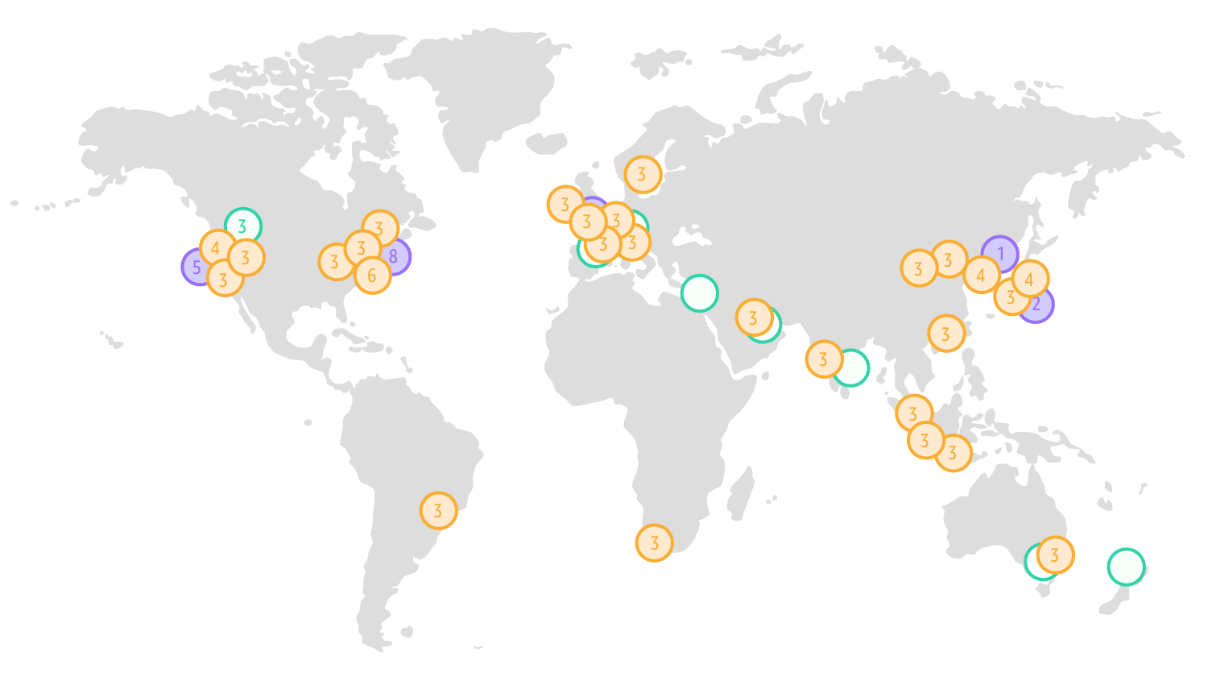
25 Regions
81 Availability Zone

Slide 13
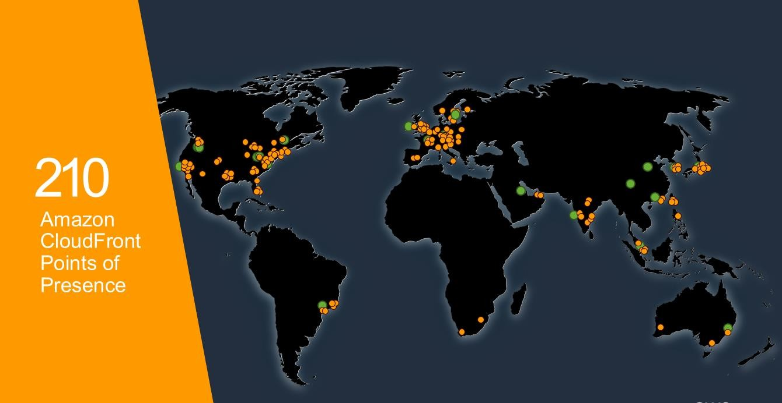

Slide 14
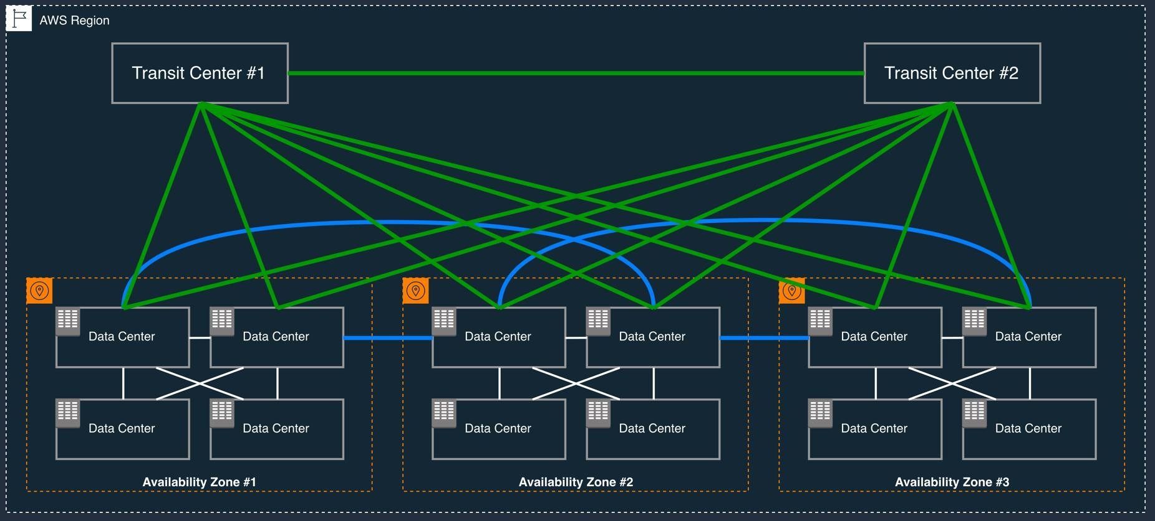
Availability Zones

